Slide 1


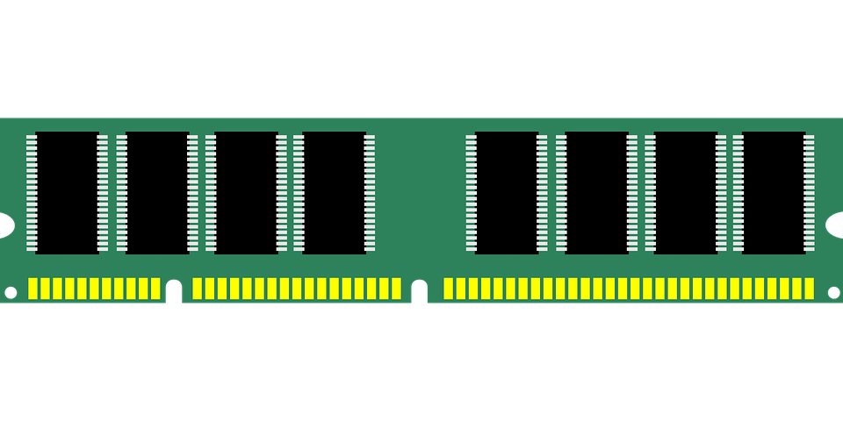


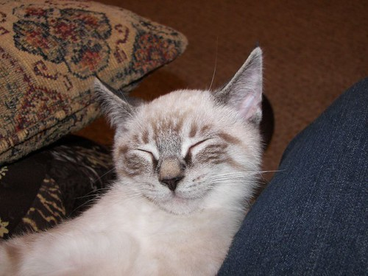







AQUA: Scalable Rowhammer Mitigation by Quarantining Aggressor Rows at Runtime
Anish Saxena†, Gururaj Saileshwar†, Prashant J. Nair‡, Moinuddin Qureshi†
†Georgia Institute of Technology, USA
‡University of British Columbia, Canada
Notes:
Make it less crowded
Speak slower, maybe reduce some content

Slide 2

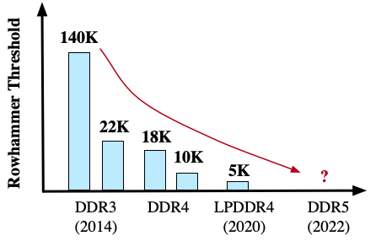
Rowhammer
Victim Row
1 1 1 1 1 1 1 1 1 1
1 1 0 1 1 1 0 1 1 1
Aggressor Row
0 0 0 0 0 0 0 0 0 0
Victim Row
1 1 1 1 1 1 0 0 0 1
1 1 1 1 1 1 1 1 1 1
Defenses must scale to plummeting Rowhammer Threshold (TRH)
Notes:
Rowhammer occurs when an aggressor row is accessed frequently causing bit flips in nearby victim rows.
Rowhammer is not just a reliability problem but a serious security threat.
Alarmingly, the threshold of activations to the aggressor that we require to cause bit flips has reduced drastically and we can expect even lower threshold in the future.
So, it is important that we develop solutions for Rowhammer that not only work at current thresholds but also for lower thresholds
Reduce words

Slide 3



Rowhammer Protection
Mitigative Action
Victim
Victim
Access
Tracker
Aggressor
T
Victim
Victim
Memory Controller
DRAM
Commerical Rowhammer mitigations rely on victim refresh
Notes:
Typical solutions for Rowhammer consists of two parts- tracking the number of accesses to each row and performing mitigative action on aggressors
Once an aggressor is identified, the typical mitigation involves refreshing the victim rows to prevent Rowhammer
Victim refresh is a commercially deployed mitigation that can be found in DDR4 modules

Slide 4
Half-Double Attack
Mitigative Action
Distance-of-2
Victim
Access
Tracker
Aggressor
T
Victim
Distance-of-2
Memory Controller
DRAM
Half-Double breaks all commercial defenses by leveraging victim refreshes
Notes:
One problem of victim refresh is it maintains the spatial proximity aggressor and victims, giving the attacker ample time to craft complex attack patterns
For example, the recently disclosed Half-Double attack from Google leverages the victim refresh itself to attack
Half Double induces so many victim refreshes in the nearby rows that it causes bit flips in neighbors at a distance-of-2
This attack breaks all commercial and proposed mitigations that rely on victim refresh

Slide 5
Randomized Row-Swap [ASPLOS’22]
Y
Access
Tracker
Row Indirection Table
T
Victim
Aggressor
Victim
X
Aggressor
Memory Controller
DRAM
RRS breaks spatial proximity by swapping the aggressor with a randomly selected row
Notes:
So victim refresh maintains spatial proximity, but what if you could break this proximity between the aggressor and victims?
Such a mitigation was recently proposed in the form of Randomized Row-Swap or RRS.
RRS performs the mitigation by swapping the aggressor with a randomly selected row in memory
And if the attackers keeps hammering the aggressor row, RRS keeps swapping it with another randomly selected row
As the location of the row in memory can change, RRS relies on an indirection table to re-route the access to the correct row location
At current thresholds, the swapping is infrequent, so the performance and SRAM overheads of RRS are small
Note that once the aggressor is swapped, the attacker should not randomly stumble upon the swapped row, in this case row X, by chance
Such attacks are known as birthday paradox attacks

Slide 6
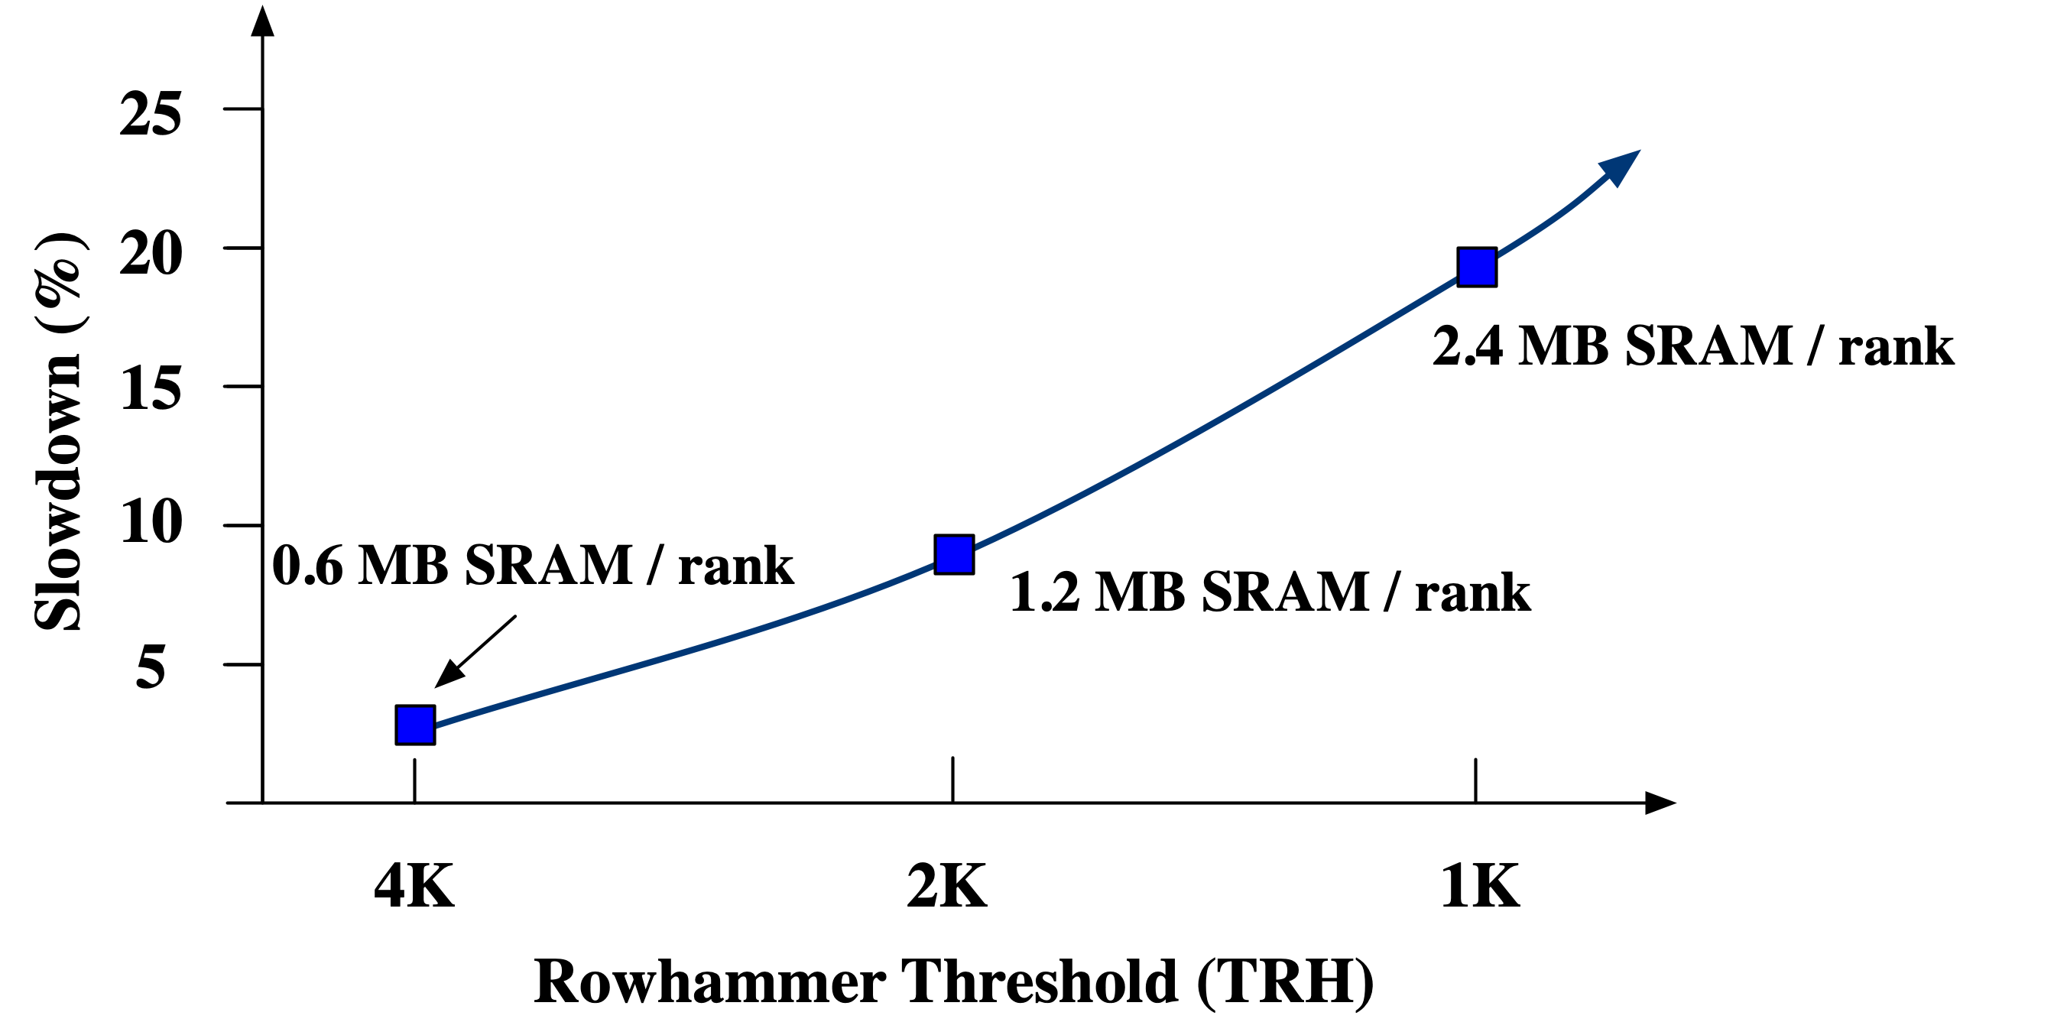

Limitations of Randomized Swaps
Security via Randomization
$T=TRH/6$
Current TRH
TRH | T = TRH/6
4K | 666
1K | 166
Our default TRH
Our goal is to develop a scalable Rowhammer mitigation with low overheads
Notes:
To avoid birthday paradox attacks, RRS needs to swap the rows much more frequently than the threshold
In-fact, the effective threshold to swap the rows is 6 times lower than the actual rowhammer threshold
This is okay for current 4K threshold, but doesn’t scale to 1K which is our default threshold because,
performance degrades due to many more mitigations launched, and
the SRAM overhead of the indirection table increases with decrease in the threshold
In this graph, we plot the with decreasing Rowhammer threshold
We see that while RRS has low overheads at 4K threshold, the SRAM requirement becomes over 2MB per rank at 1K and the slowdown becomes 20% which is unacceptable
Our goal is to develop a solution that is scalable to lower thresholds

Slide 7
AQUA: Quarantining Aggressors
Access
Tracker
Forward Pointer Table
T
Victim
Aggressor
Victim
Reverse Pointer Table
Aggressor
Memory Controller
DRAM
Quarantine Region (QR)
Security guarantee: $Activation(any_row)<T$
Security via Isolation: AQUA moves rows to a dedicated region of memory
Notes:
AQUA where our key insight is to use isolation instead of randomization to mitigate Rowhammer
We quarantine the aggressors in a dedicated quarantine region of memory which is inaccessible by software
To perform a mitigation, AQUA moves the aggressor to a row in the quarantine region
If attacker keeps accessing the same row, AQUA moves it to next available row in the quarantine region
The quarantine region is logically a circular buffer
As the row might reside in either its original location or in a row in the quarantine region, a forward pointer table is consulted on each access to reveal its correct location
For each row in the quarantine location, a reverse pointer table stores the row it is quarantining that is useful to move the row back to its original location when its evicted
The security guarantee is that no row, including rows in the quarantine region, receives more than the threshold number of activations
A key parameter to ensure AQUA’s is the quarantine region size- too small and it may prematurely evict an aggressor as it is a logical buffer, potentially leading to bit flips
Too large and it leads to unnecessary DRAM capacity loss
So let’s find out how the quarantine region is sized

Slide 8
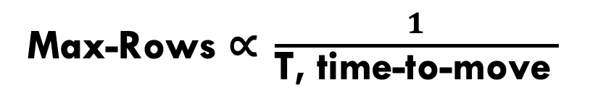
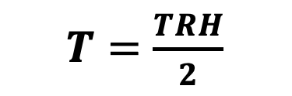

Sizing the quarantine region
$T=\frac{TRH}{2}$
Quarantine Region Size $≥$ Max-Rows
T | DRAM overhead (16GB memory)
500 | 1.1%
250 | 1.5%
125 | 1.8%
Max-Rows$\text{∝} \frac{1}{\text{T}\text{, }\text{time}\text{−}\text{to}\text{−}\text{move} }$
Time spent performing row migration
Reserving 1-2% of DRAM for the quarantine region prevents Rowhammer
Notes:
We find that reserving 1.1% of DRAM prevents Rowhammer at an effective Rowhammer threshold of 500.
Moreover, even for a much lower threshold of 125, we only need to reserve about 1.8% of DRAM.
Note that the size of quarantine region should at least accommodate all potential aggressors at any given time
We find that it depends not only on the effective threshold, as we expect more rows to potentially be aggressors at lower thresholds,
But this size also the time spent in performing row migrations
This is because the memory bus is unserviceable for the duration of the migration, effectively reducing the time for the attacker to hammer rows
Only require reserving about 1-2% of DRAM to prevent rowhammer
So this is the cost of AQUA, let’s discuss the benefits in terms of performance and SRAM overhead

Slide 9
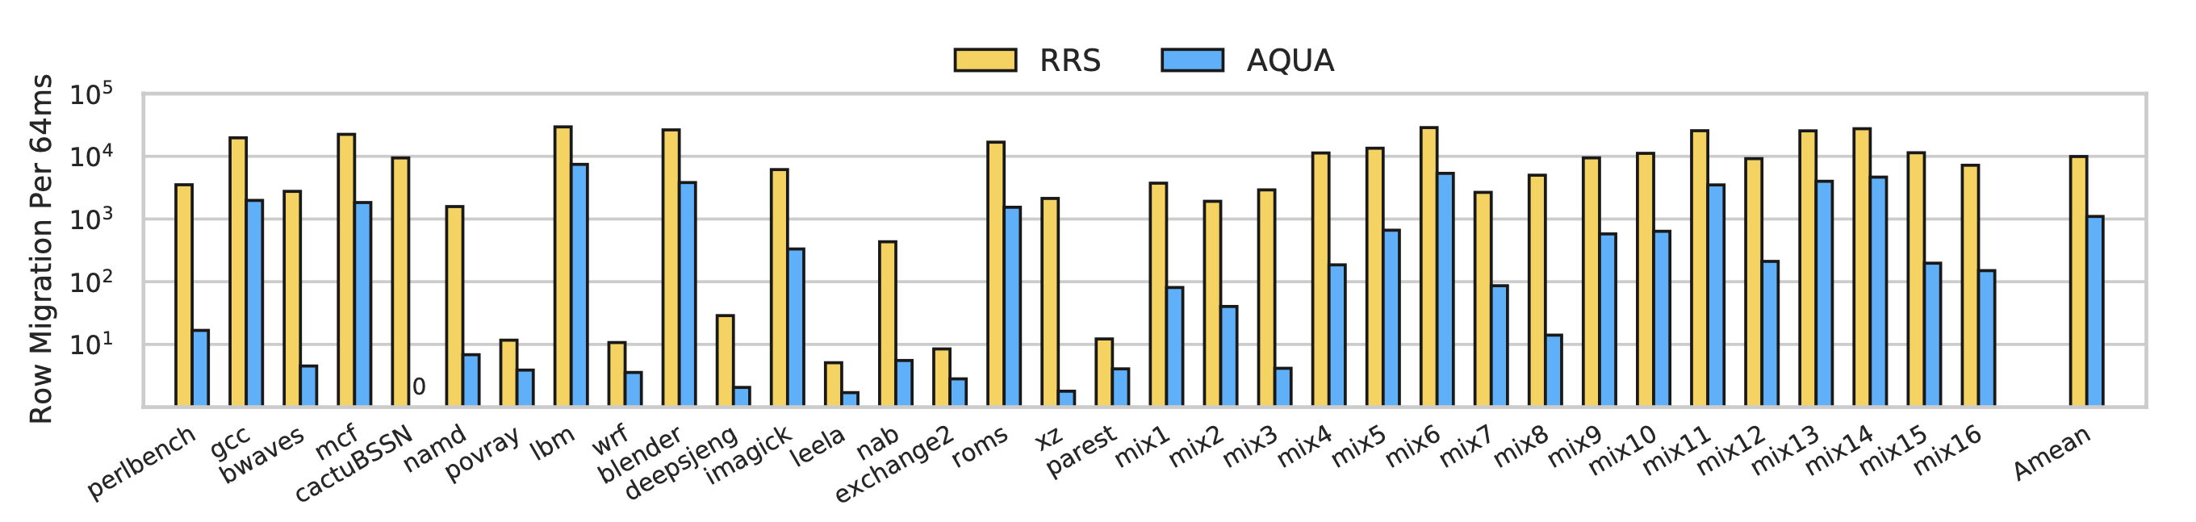
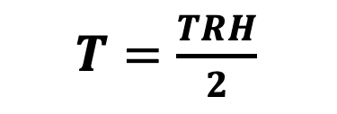
Row migrations
$T=\frac{TRH}{2}$
Row migrations reduce by 9X as less mitigations are performed
Notes:
The performance of AQUA depends on the number of row migrations
and the number of migrations depends on how many migrations you perform for each mitigation
AQUA performs just 1 migration for each mitigation
The numbers of mitigations is just the mitigations launched for every row that needs a mitigations
AQUA works at the same effective threshold as the tracker, so for a Rowhammer threshold of 1K we quarantine after every 500 activations
And only few rows even cross 500 activations, around 700 for effective threshold of 500.
So that results in only about 1000 row migrations per 64ms as we see on the graph for multi-core gem5 simulations of SPEC17 workloads
In fact, this is an order of magnitude lower than RRS owing to a higher threshold in AQUA and less rows ever reaching 500 activations

Slide 10
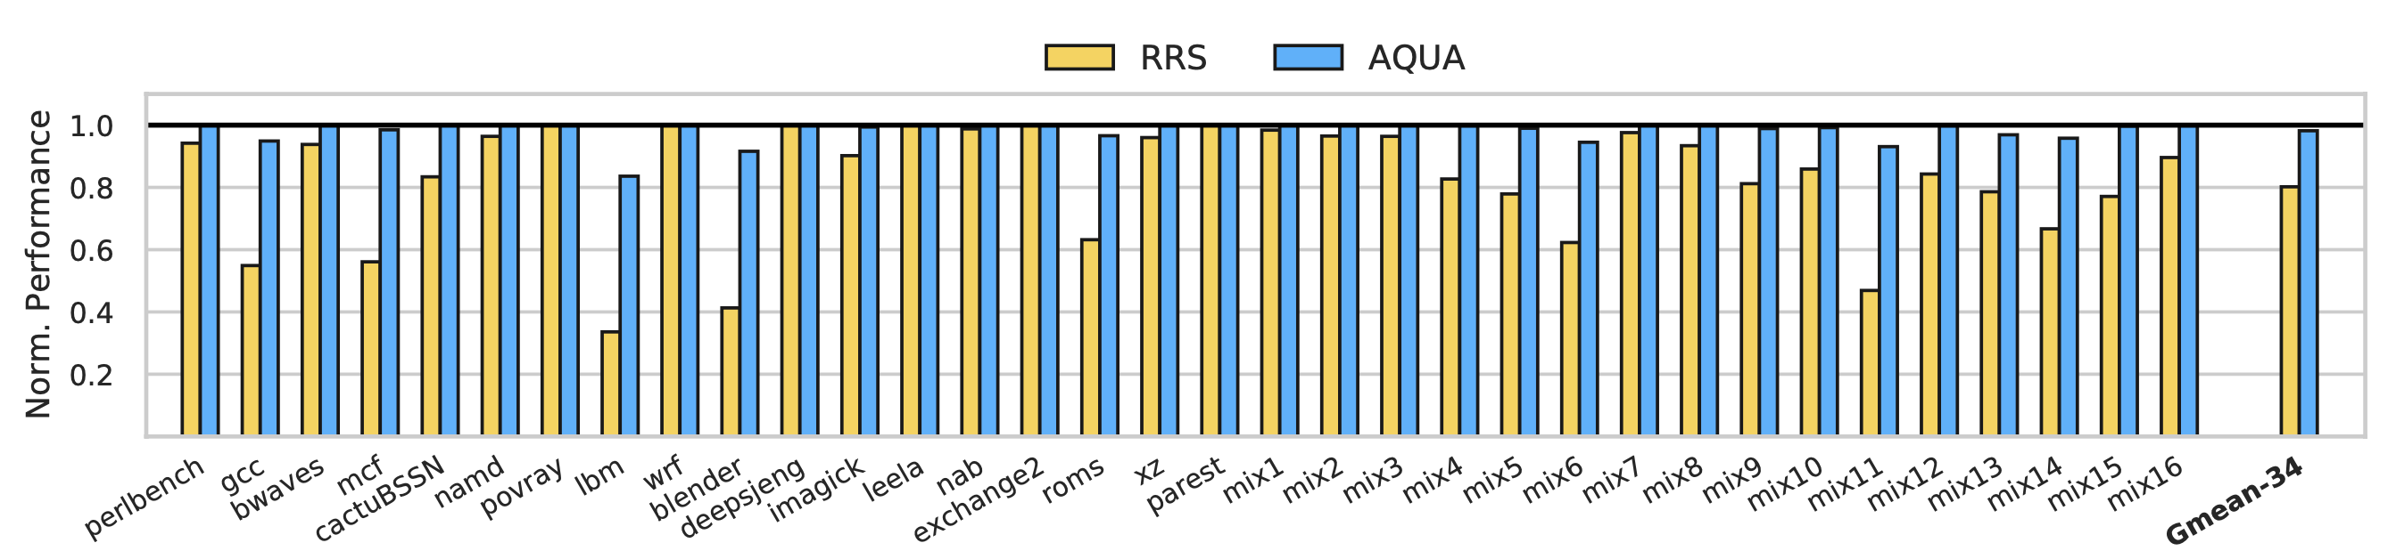
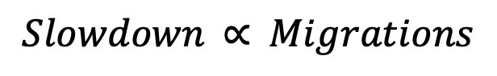
performance
$$Slowdown \text{∝} Migrations$$
Slowdown in AQUA: 1.8% Slowdown in RRS: 19.8%
Less migrations leads to 11X reduction in slowdown
Notes:
As lookup to the SRAM-based indirection tables is fast, the performance overhead is dominated by the number of migrations
Here we see the normalized performance for RRS and AQUA on y axis for SPEC17 workloads in multi-core gem5 simulations
As AQUA migrates much less, the performance overhead is similarly an order of magnitude lower than RRS
Explain what the graph is

Slide 11
sram overhead
RRS | 2.4 MB/rank
AQUA-SRAM | 172 KB/rank
AQUA-DRAM | 32 KB /rank
Indirection Tables
Slowdown
1.8% → 2.1%
Indirection Tables
Not a secret
SRAM overhead for AQUA’s mitigation is 41KB per rank, 60X lower than RRS
Notes:
The SRAM overhead comes from the indirection tables which can get quite large
For example, the recently proposed Hydra tracker requires 30KB of SRAM to maintain tracker state
Meanwhile RRS requires 2.4MB- almost 80X more SRAM for its tables, and while AQUA fares much better at 172 KB, it is still considerable
Let’s reduce this.
While RRS needs constant lookup latency for indirection tables to maintain security, there is no such restriction in AQUA
This is because the destination row of the quarantine region is not a secret
So we memory-map the indirection tables in DRAM and cache them on-demand
This reduces our indirection overhead significantly to 32KB per rank while only increasing the slowdown slightly from 1.8% to 2.1%
I refer to our paper for a description of our optimizations
AQUA’s SRAM overhead to perform mitigations is just 41 KB per rank, 60X lower than RRS

Slide 12

Thank You
conclusion
Breaks spatial proximity by isolating aggressors in 1-2% DRAM
Uses the same effective threshold as the tracker
Fewer rows need mitigation and fewer mitigations per row
60X less SRAM and 11X less slowdown compared to RRS
https://tinyurl.com/AQUA-code
Notes:
The threat of Rowhammer is getting worse due to lowering threshold
Previous row migration ideas have high overheads, we reduce using isolation which is our key insight
The cost of our solution is reserving 1-2% DRAM and the benefit is orders of magnitude less SRAM and performance overhead, enabling a scalable solution
Please feel free to get the gem5 implementation using the URL or QR code
Thanks for your attention and I will be happy to take questions

Slide 13
BACKUP SLIDES

Slide 14
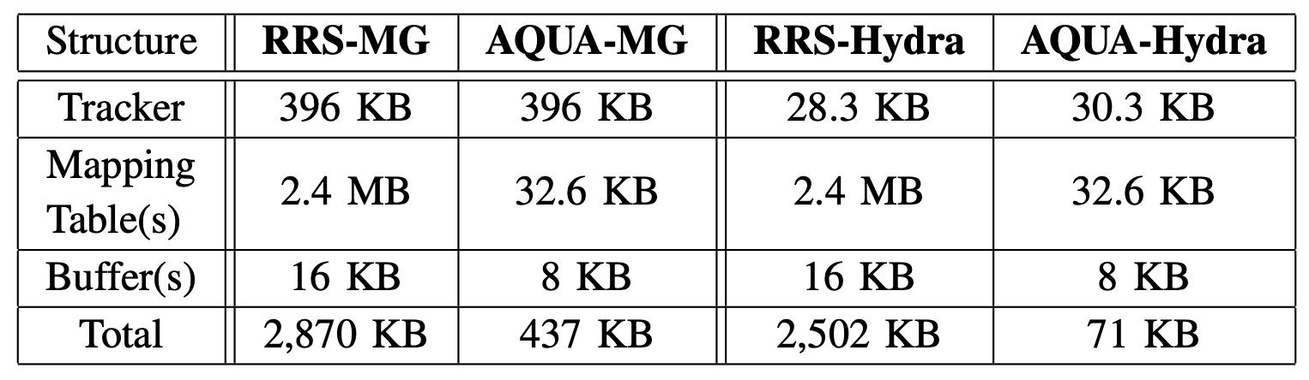
Tracker overheads
TRH = 1K

Slide 15
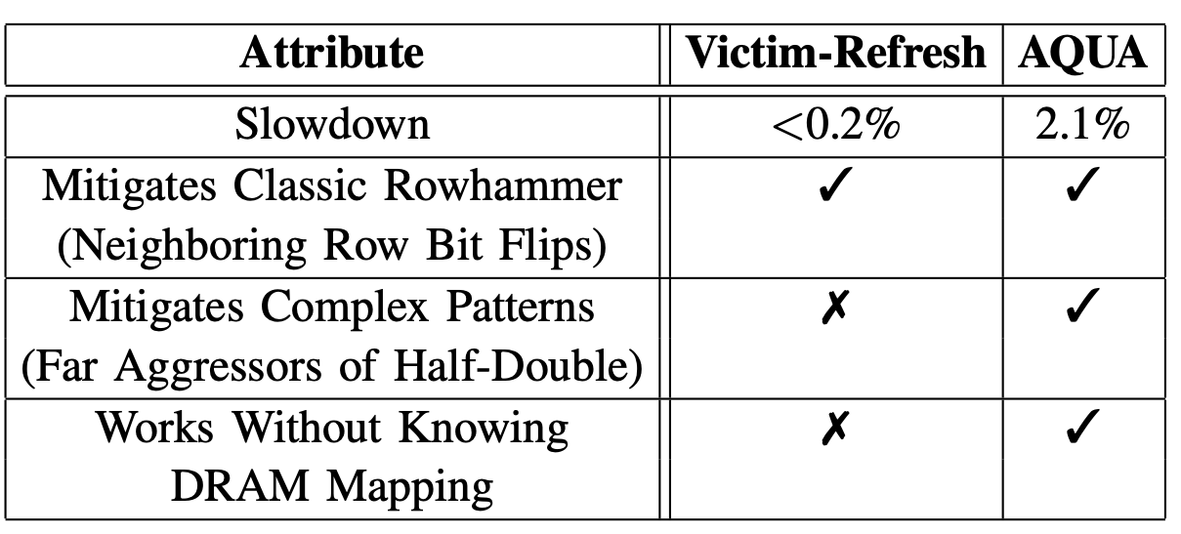
Aqua compared to victim refresh

Slide 16
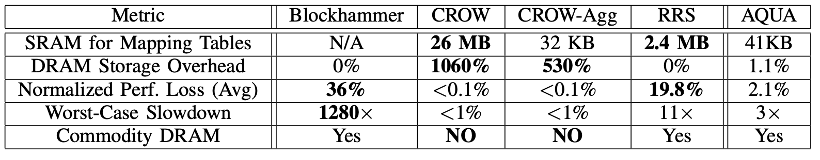
Aqua compared to prior works

Slide 17
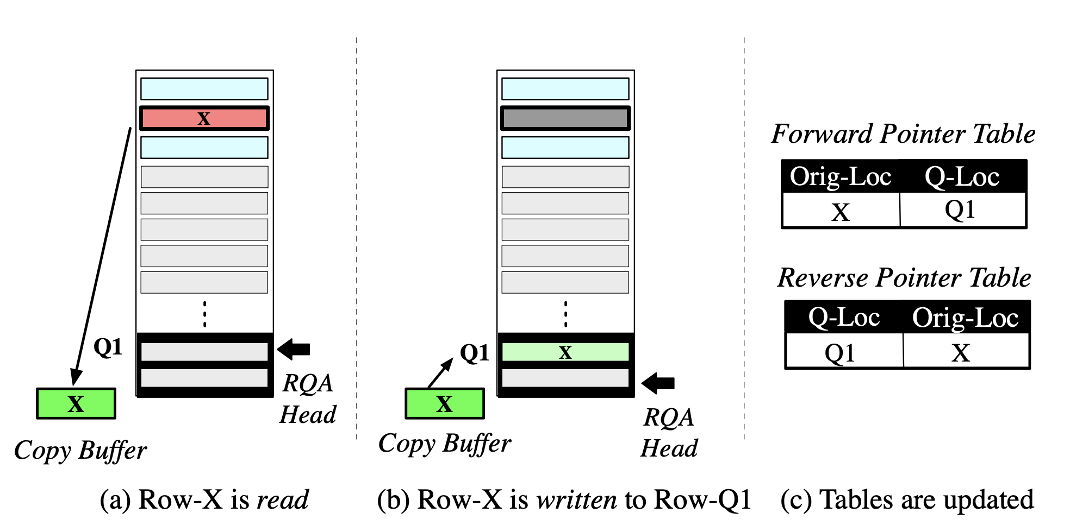
Row migration with sram-based copy buffer

Slide 18
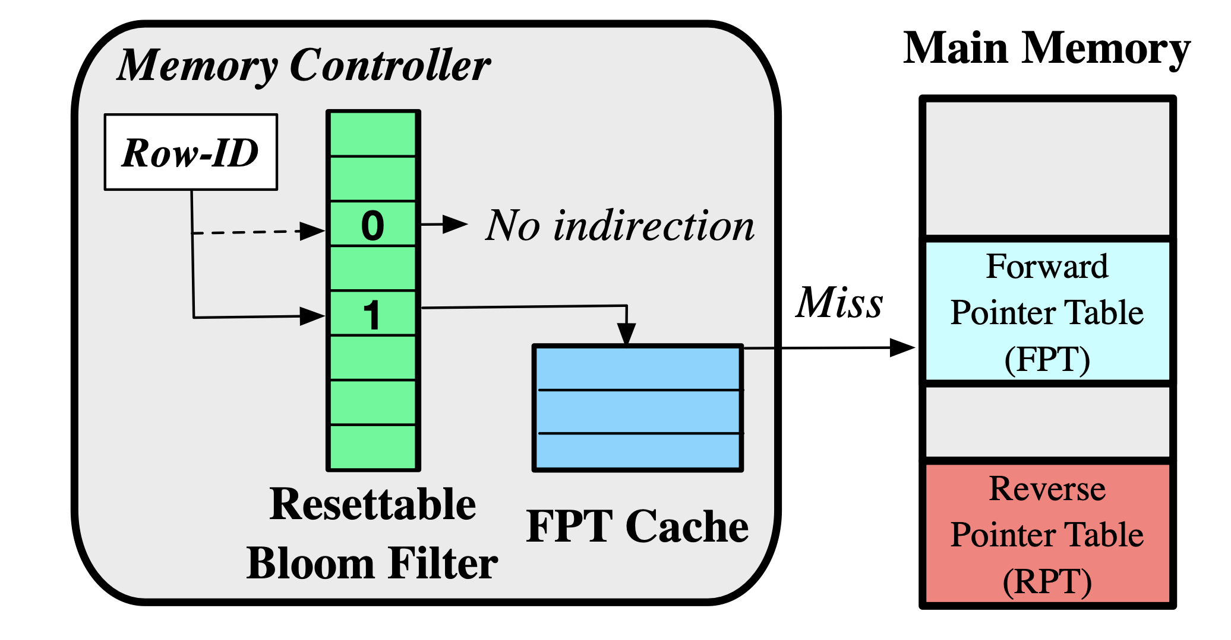
Aqua with Memory-mapped tables

Slide 19
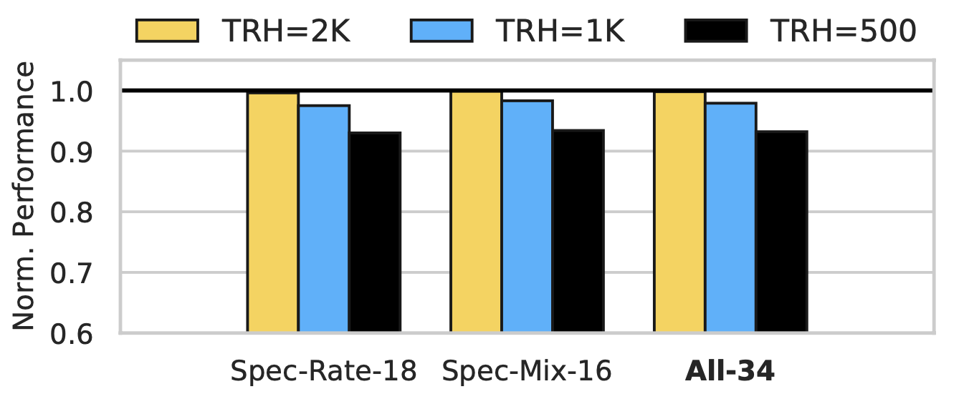
Sensitivity to rowhammer threshold

Slide 20
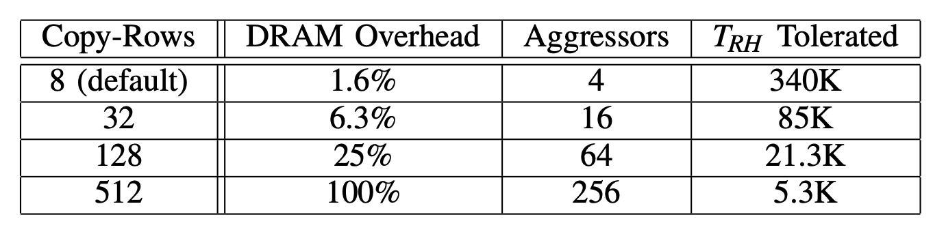
Overheads of crow

Slide 21
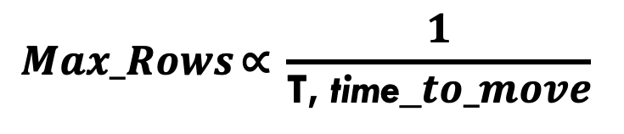
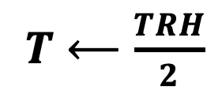
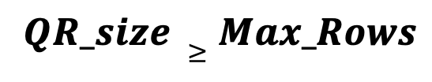
Sizing the quarantine region
Quarantine Region
T | DRAM overhead (16GB memory)
500 | 1.1%
250 | 1.5%
125 | 1.8%
Security via Isolation
$QR_size ≥Max_Rows$
$$Max_Rows \text{∝} \frac{1}{\text{T}\text{, }\text{time}\text{_}to_move}$$
$T⟵\frac{TRH}{2}$
Due to tracker inefficiency
Time spent performing row migration
Reserving 1-2% of DRAM for the quarantine region is sufficient to prevent Rowhammer
Notes:
As AQUA relies on isolation for security, there is no artificial reduction in threshold and we use half of the Rowhammer threshold in AQUA due to tracker inefficiencies
So for a threshold of 1K, we move the aggressor after 500 activations
The quarantine region should fit the maximum possible number of aggressors, which we find out depends not only on the threshold, but also the time spent in performing row migrations
This is because the memory bus is unserviceable for the duration of the migration, effectively reducing the time for the attacker to hammer rows
And we only require reserving about 1-2% of DRAM to prevent rowhammer
So this is the cost of AQUA, let’s discuss the benefits in terms of performance and SRAM overhead

Slide 22
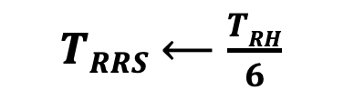


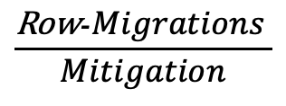
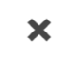
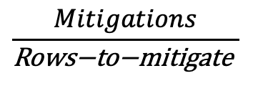
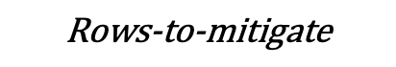
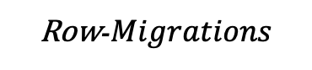
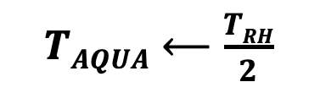
Row migrations
$$\frac{\text{Row}\text{−}Migrations }{Mitigation}$$
$$\frac{Mitigations}{\text{Rows}\text{−}\text{to}\text{−}\text{mitigate} }$$
Row-$Migrations$
$$✖️$$
$$✖️$$
$$\text{∝}$$
$$\text{Rows}\text{−}\text{to}\text{−}\text{mitigate}$$
$TRRS⟵\frac{TRH}{6}$
Workload | Rows with ACT-166+ | Rows with ACT-500+
Average | 1,665 (2.4X) | 694
$TAQUA⟵\frac{TRH}{2}$
RRS
AQUA
Row migrations reduce by 9X as less mitigations are performed
Notes:
Both RRS and AQUA perform row migrations for mitigation but AQUA is much more efficient. Let us see why
Number of migrations depend on the cost of each mitigation, and AQUA only needs one row-migration for every mitigation
The number of mitigations for each is a further 3X lower in AQUA as it operates at a 3X higher threshold, which makes for 6X lower migrations
But that’s not it, more than twice as many rows receive 166 activations compared to rows that ever reach 500 activations
This makes for an order of magnitude reduction in migrations
Here we plot the number of row migrations on y-axis performed by RRS and AQUA in 64ms, notice the y-axis is in log scale using multi-core gem5 simulations with SPEC2017 workloads, we indeed see an order of magnitude difference in migrations, as expected

Slide 23
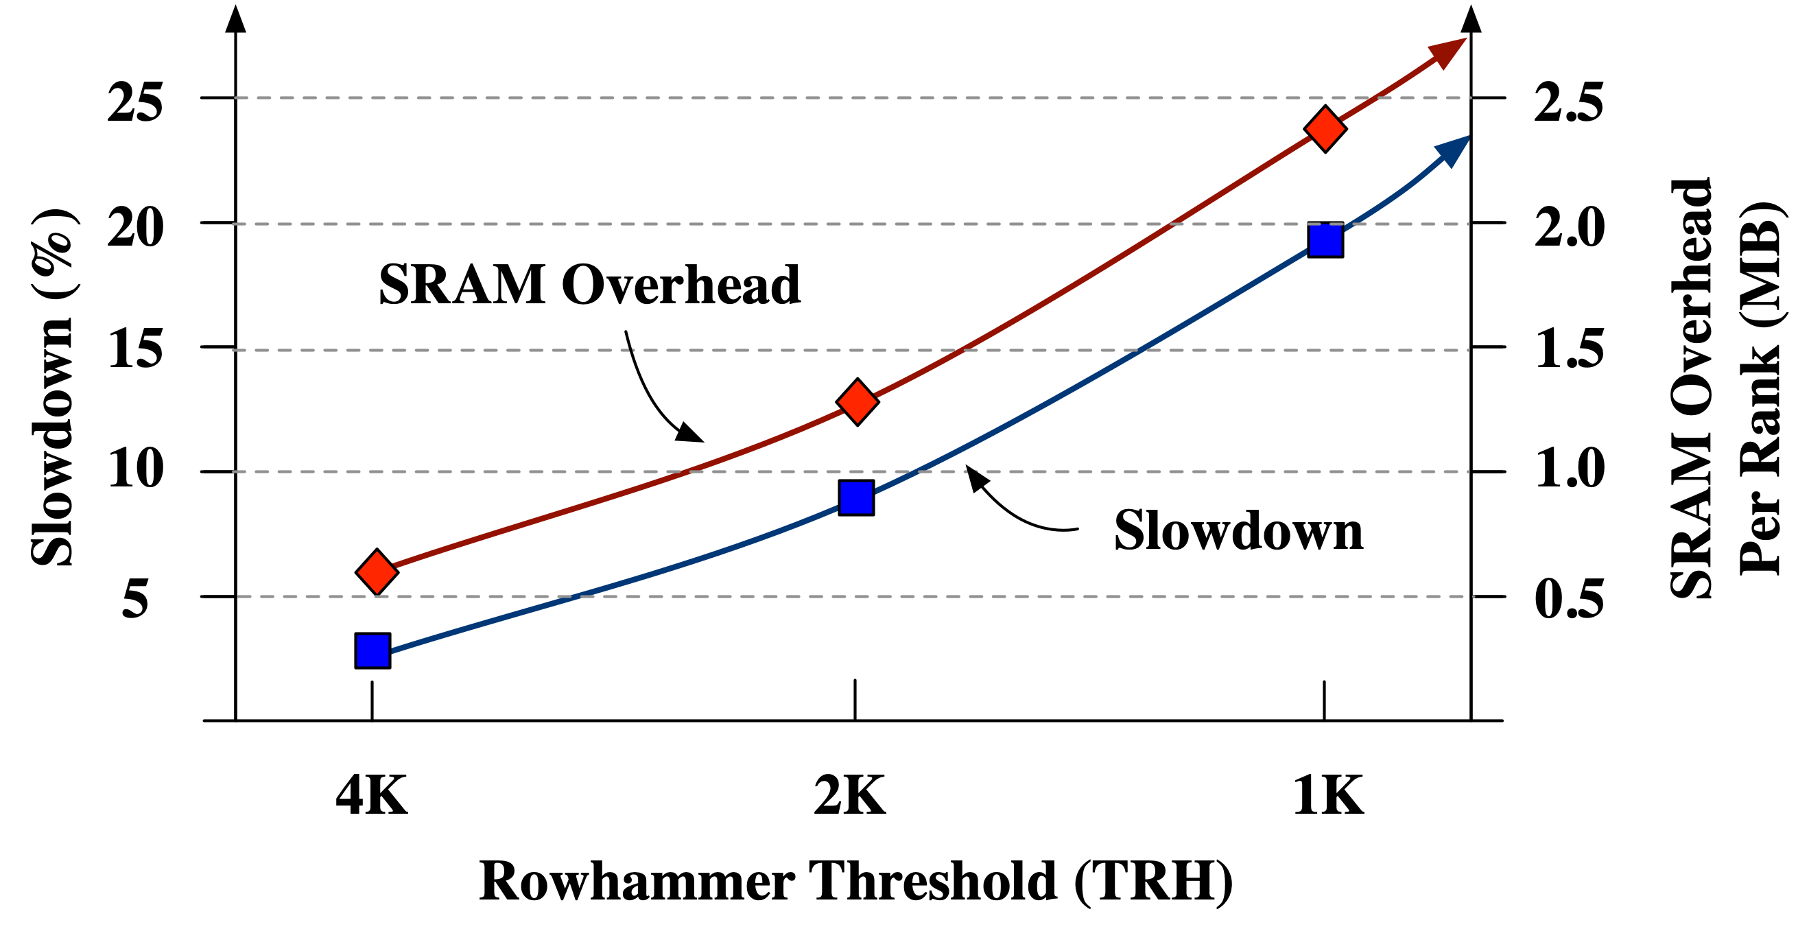
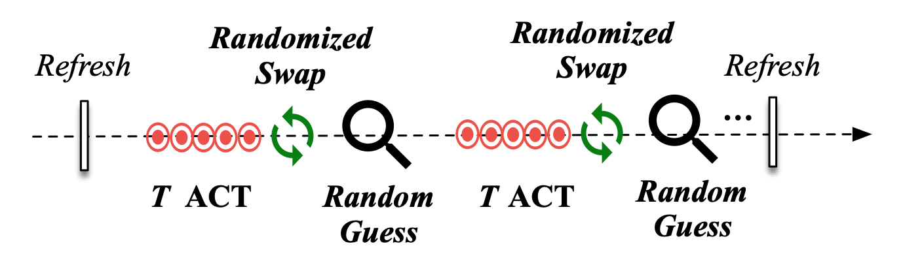
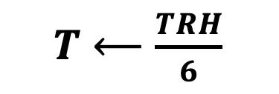
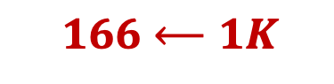
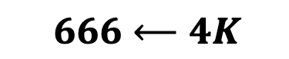
Limitations of Randomized Swaps
Security via Randomization
$T⟵\frac{TRH}{6}$
Current TRH
$666⟵4K$
$166⟵1K$
Our default TRH
Our goal is to develop a scalable Rowhammer mitigation with low overheads
Notes:
Since RRS relies on randomization, when you move an aggressor to a another row, the attacker shouldn’t accidently stumble upon this row
This type of attack is called birthday paradox attack
To avoid birthday paradox attacks, RRS needs to swap the rows much more frequently than the threshold
In-fact, the effective threshold to swap the rows is 6 times lower than the actual rowhammer threshold
This is okay for current 4K threshold, but doesn’t scale to 1K which is our default threshold because,
performance degrades due to many more mitigations launched, and
the SRAM overhead of the indirection table increases with decrease in the threshold
In this graph, we plot the slowdown on left and SRAM overhead on right axes with decreasing Rowhammer threshold on x axis.
We see that while RRS has low overheads at 4K threshold, the SRAM requirement becomes over 2MB per rank at 1K and the slowdown becomes 20% which is unacceptable
Our goal is to develop a solution that is scalable to lower thresholds

Slide 24
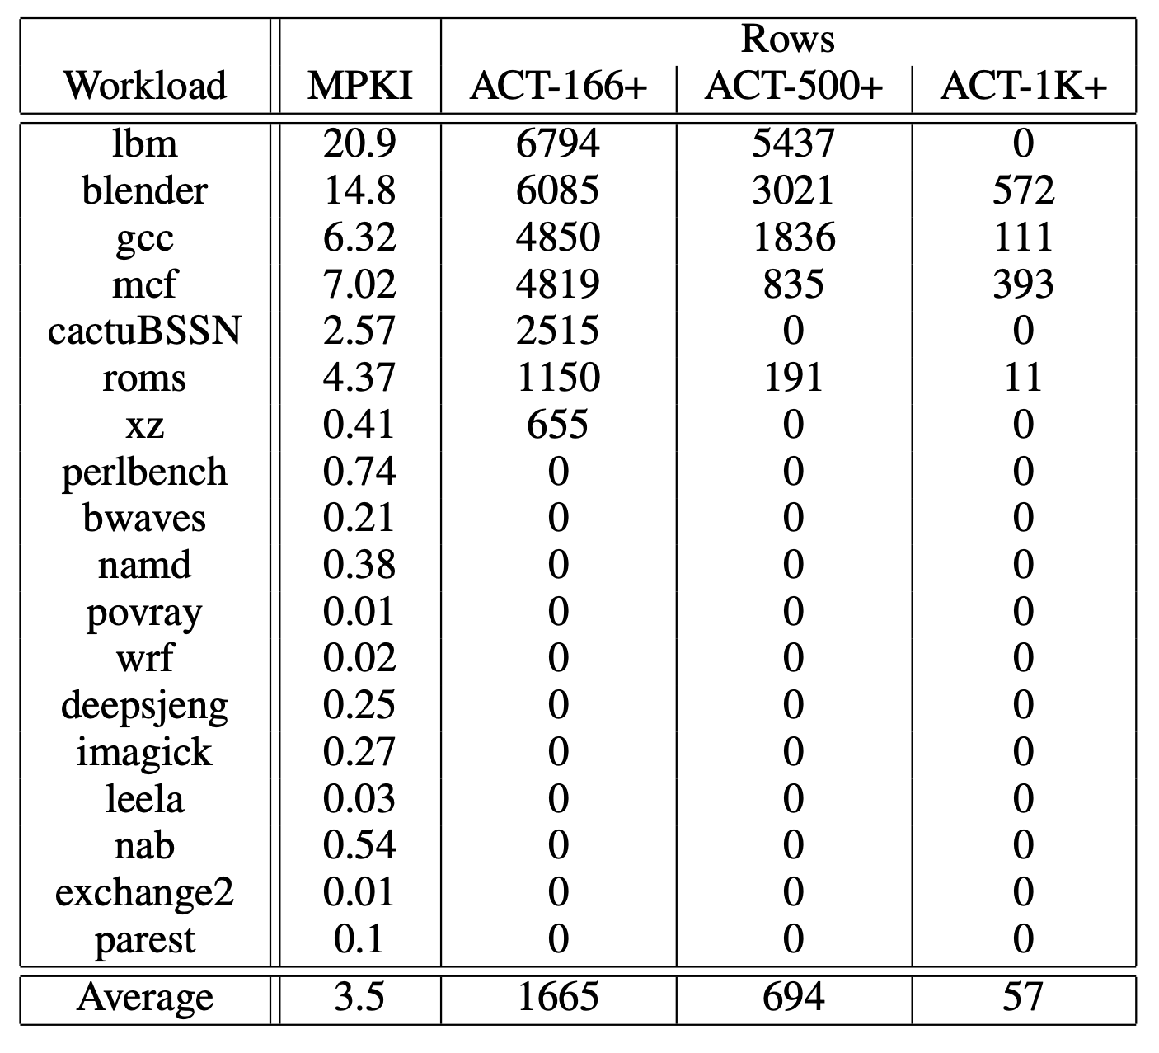
Spec2017 row activation characteristics

Slide 25
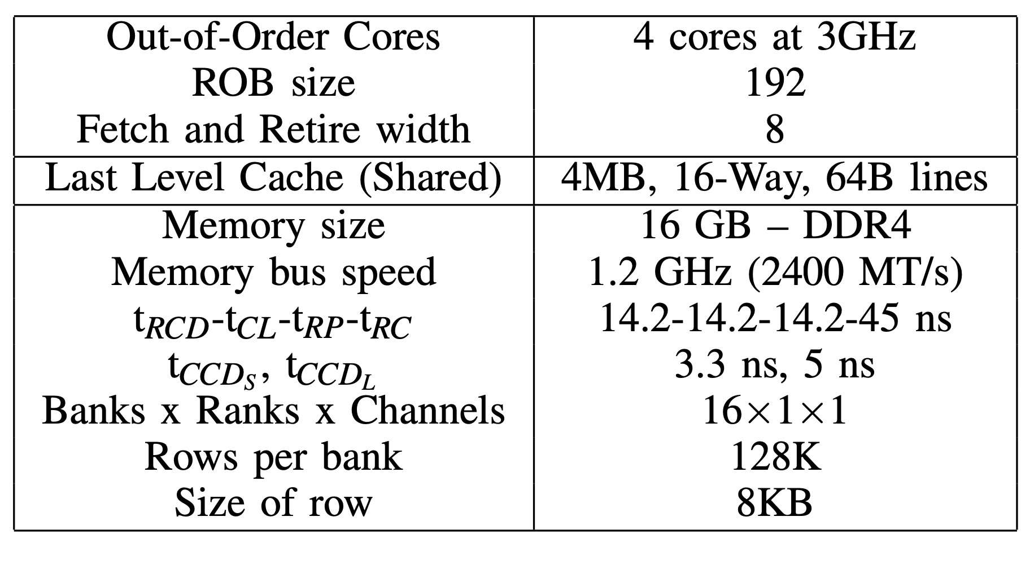
Experimental setup
18 SPEC2017 rate and 16 mixed workloads
Fast-forward by 25 Bn instructions
Simulate for 250 Mn instructions

Slide 26
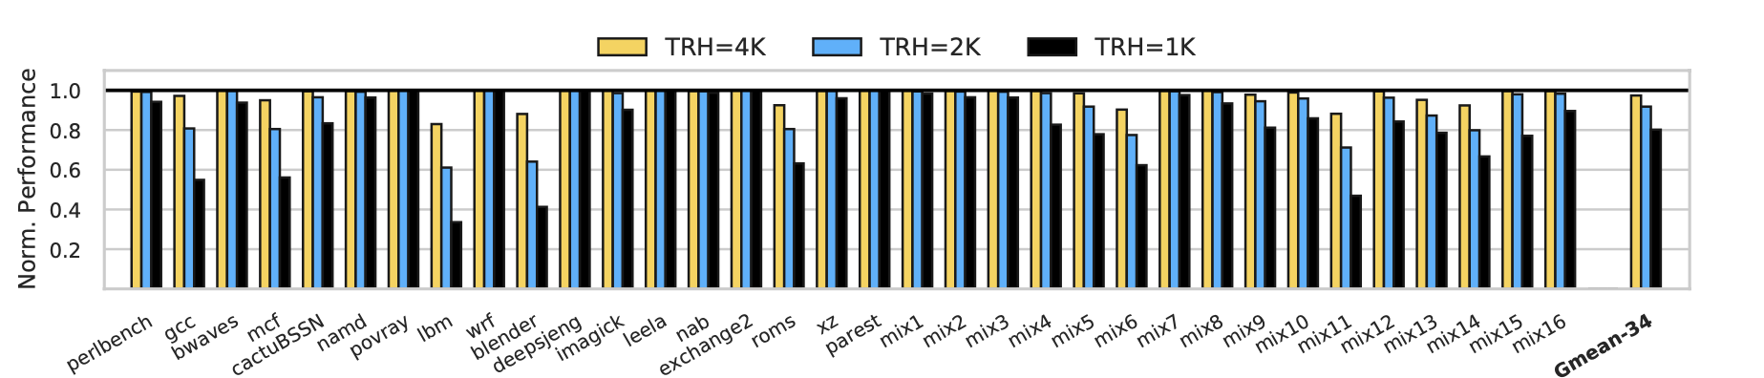
Performance degradation of rrs

Slide 27
Notes:
Repeat the questions
Comparison tables from paper
Clarity, conciseness, take it offline if it gets long
CROW: changes to substrate, high thresholds, overheads explode at low thresholds

Slide 28
AQUA: Quarantining Aggressors
Victim
Victim
Aggressor
Victim
Victim
Aggressor
DRAM
DRAM
Quarantine Region (QR)
Security via Isolation: AQUA moves rows to a dedicated memory region
Notes:
AQUA where our key insight is to use isolation instead of randomization to mitigate Rowhammer
We quarantine the aggressors in a dedicated quarantine region of memory which is inaccessible by software
To perform a mitigation, AQUA moves the aggressor to a row in the quarantine region
If attacker keeps accessing the same row, AQUA moves it to next available row in the quarantine region
The quarantine region is logically a circular buffer
As the row might reside in either its original location or in a row in the quarantine region, a forward pointer table is consulted on each access to reveal its correct location
For each row in the quarantine location, a reverse pointer table stores the row it is quarantining that is useful to move the row back to its original location when its evicted
The security guarantee is that no row, including rows in the quarantine region, receives more than the threshold number of activations
A key parameter to ensure AQUA’s is the quarantine region size- too small and it may prematurely evict an aggressor as it is a logical buffer, potentially leading to bit flips
Too large and it leads to unnecessary DRAM capacity loss
So let’s find out how the quarantine region is sized

Slide 29
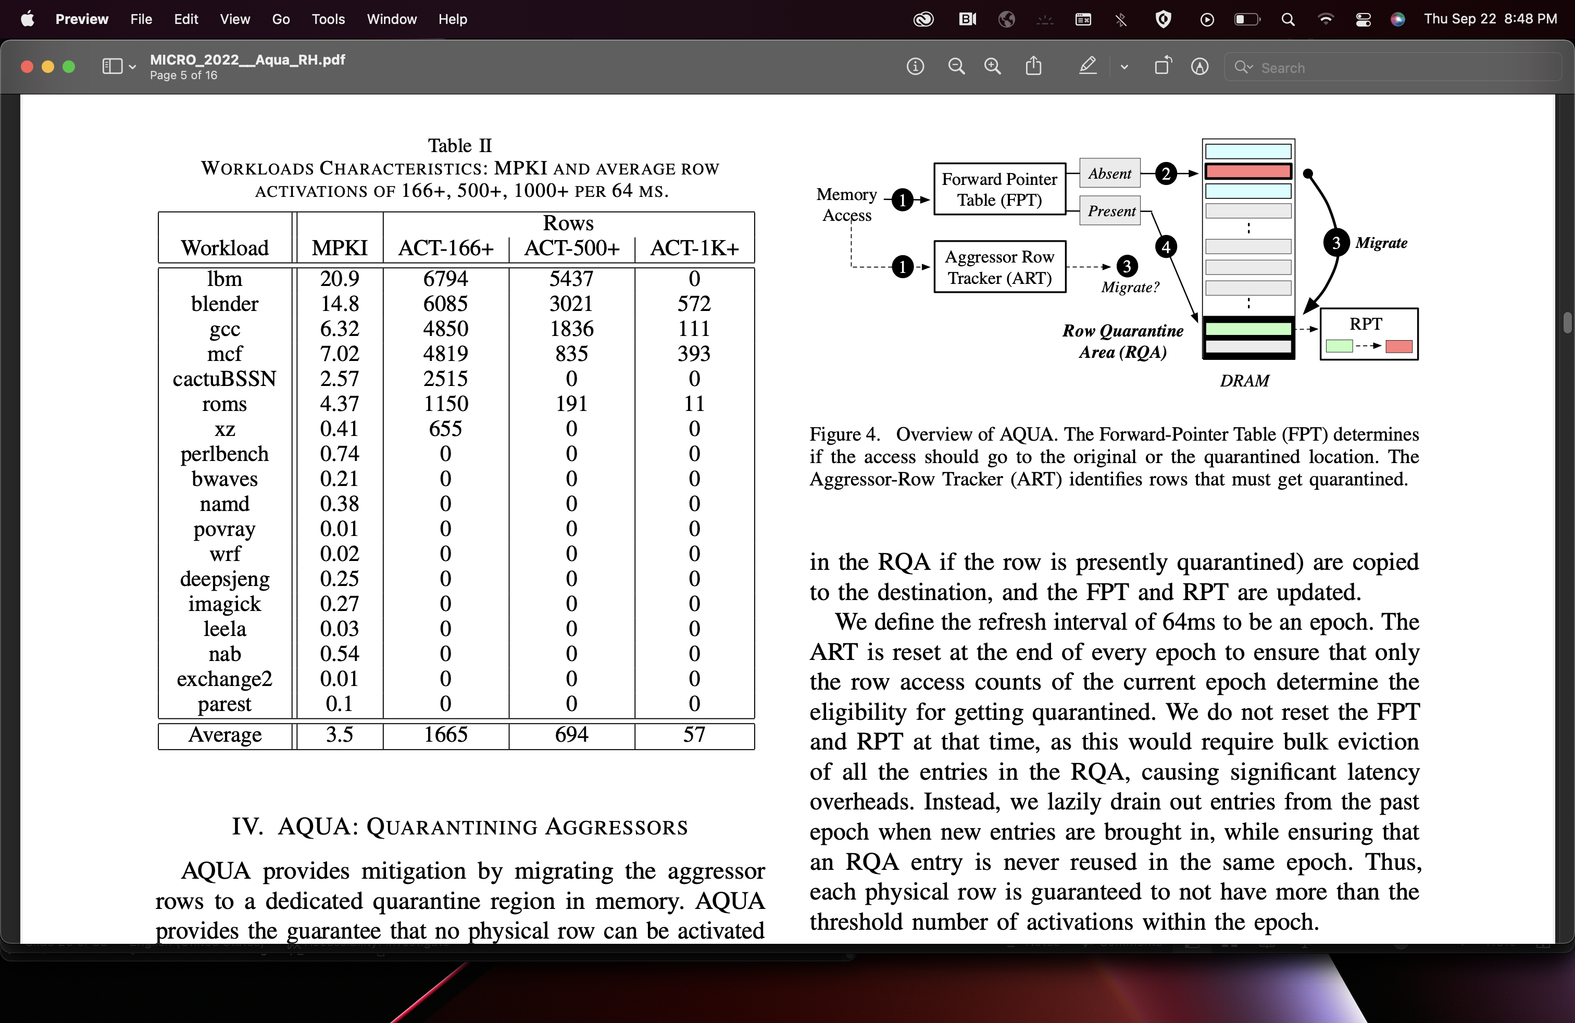
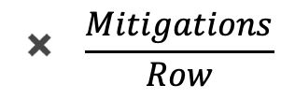

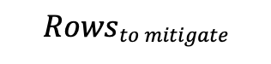
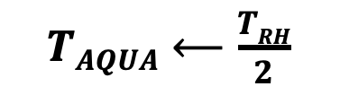
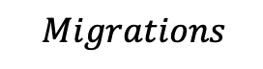
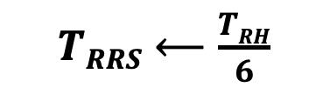
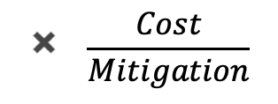
Row migrations and performance
$Migrations$
$$\text{∝}$$
$$Rowsto mitigate$$
$$✖️ \frac{Mitigations}{Row}$$
$$✖️ \frac{Cost}{Mitigation}$$
$$Perfloss\text{∝} Migrations$$
Workload | ACT-166+ | ACT-500+ | ACT-1K+
lbm | 6,794 | 5,437 | 0
blender | 6,085 | 3,021 | 572
gcc | 4,850 | 1,836 | 111
. | . | . | .
Average | 1,665 (29X) | 694 (12X) | 57
$TRRS⟵\frac{TRH}{6}$
$TAQUA⟵\frac{TRH}{2}$
Slowdown in AQUA: 1.8% Slowdown in RRS: 19.8%
Higher effective T_{RH} leads to an order of magnitude less row migrations and slowdown
Notes:
As we do not artificially reduce the RTH, we also perform substantially less row migrations
First, fewer rows ever reach 500 ACTs compared to 166 ACTs
Second, fewer mitigations are issued for rows that reach the 500 ACTs
Third, each mitigation is cheaper due to move operation (one migration) compared to swap operation (two migrations)
Overall, this results in 9X less row migrations
- The performance of RRS and AQUA is primarily determined by row migrations as indirection table lookup is fast
An order of magnitude less migrations results in 11X less performance loss in AQUA
7 MIN MARK
Graphs and fonts

Slide 30
Memory-mapping the tables
32KB per rank!
AQUA’s hybrid design reduces SRAM to 41KB per rank, 60X lower than RRS
Notes:
As FPT is consulted on every access, we cache its recently used entries to enable fast lookup
Moreover, as only a small subset of rows are ever quarantined, 23K at most out of 2 million rows, we should filter out accesses to non-quarantined rows
We do so by using an efficient bloom filter which, on average, filters out most DRAM access and takes FPT out of their critical path
The cache provides row mappings for most accesses that are quarantined
Overall, such a hybrid design has a negligible performance loss of 2.1% compared to SRAM-only version which has 1.8%
In return, we reduce the SRAM overhead to a negligible 41KB per rank
Neither the filter nor the cache size is strictly dependent on RTH or security, making this overhead a microarchitectural optimization than a security requirement
8 MIN MARK

Slide 31
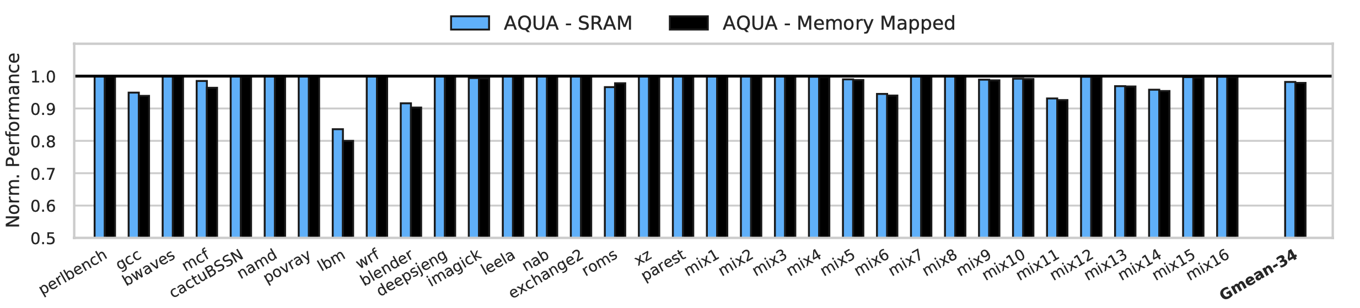
Performance of hybrid aqua
Hybrid AQUA incurs 2.1% performance loss compared to 1.8% for SRAM-based design
Notes:
As FPT is consulted on every access, we cache its recently used entries to enable fast lookup
Moreover, as only a small subset of rows are ever quarantined, 23K at most out of 2 million rows, we should filter out accesses to non-quarantined rows
We do so by using an efficient bloom filter which, on average, filters out most DRAM access and takes FPT out of their critical path
The cache provides row mappings for most accesses that are quarantined
Overall, such a hybrid design has a negligible performance loss of 2.1% compared to SRAM-only version which has 1.8%
In return, we reduce the SRAM overhead to a negligible 41KB per rank
Neither the filter nor the cache size is strictly dependent on RTH or security, making this overhead a microarchitectural optimization than a security requirement
9 MIN MARK

Slide 32

Thank You
!!
AQUA: Scalable Rowhammer Mitigation by Quarantining Aggressor Rows at Runtime
Get the code!
https://github.com/Anish-Saxena/aqua_rowhammer_mitigation

Slide 33
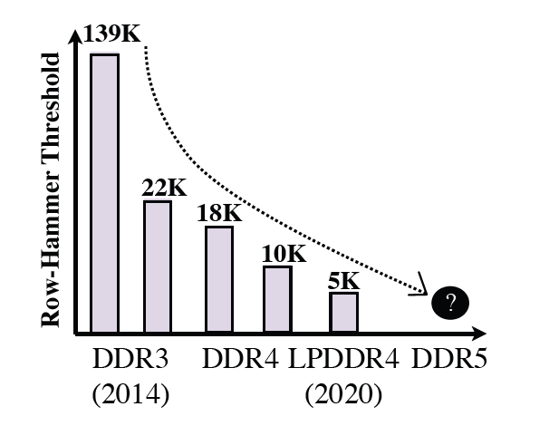



What is Rowhammer, why it matters
Row
Chips
Banks
Rank
1 1 1 1 1 1 1 1 1 1
~64ms
Refresh
Every 64ms
DIMM
1 0 1 1 0 0 0 1 1 1
Chip
Rowhammer
Bank
Victim Row
1 1 1 1 1 1 1 1 1 1
1 1 0 1 1 1 0 1 1 1
ACT
Aggressor Row
0 0 0 0 0 0 0 0 0 0
Victim Row
1 1 1 1 1 1 0 0 0 1
1 1 1 1 1 1 1 1 1 1
Frequent ACTs induces bit flips in neighboring rows

Slide 34

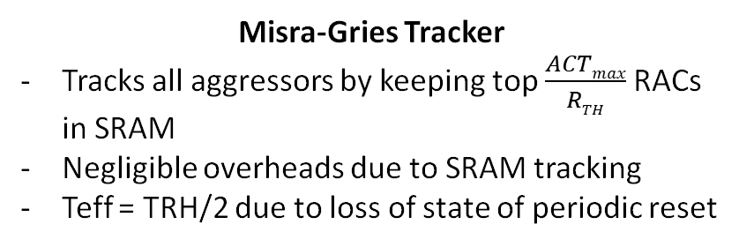
Rowhammer Defense: Tracking and Mitigation
Track aggressor rows
Perform mitigative action
Distance-2
Victim
Access(R_{A})
Aggressor
Half-Double Attack
Mitigative Action
Victim
Distance-2
CRA
TRR
Misra-Gries Tracker (per bank)
Access(RAC_{A})
RAC_{A} == R_{TH}?
Refresh R_{A-1} and R_{A+1}
RAC Cache
RAC == R_{TH}?
R_{A}
RAC_{A}
RAC_{A}++
RAC_{A}
Tracker
Misra-Gries Tracker
Tracks all aggressors by keeping top $\frac{ACTmax}{RTH}$RACs in SRAM
Negligible overheads due to SRAM tracking
Teff = TRH/2 due to loss of state of periodic reset
Mitigation preserves spatial proximity
Ample time for attacker to use clever attack patterns
Increasing mitigation radius to n leaves +-(n+1) rows vulnerable to Half-Double
Need to break spatial proximity

Slide 35

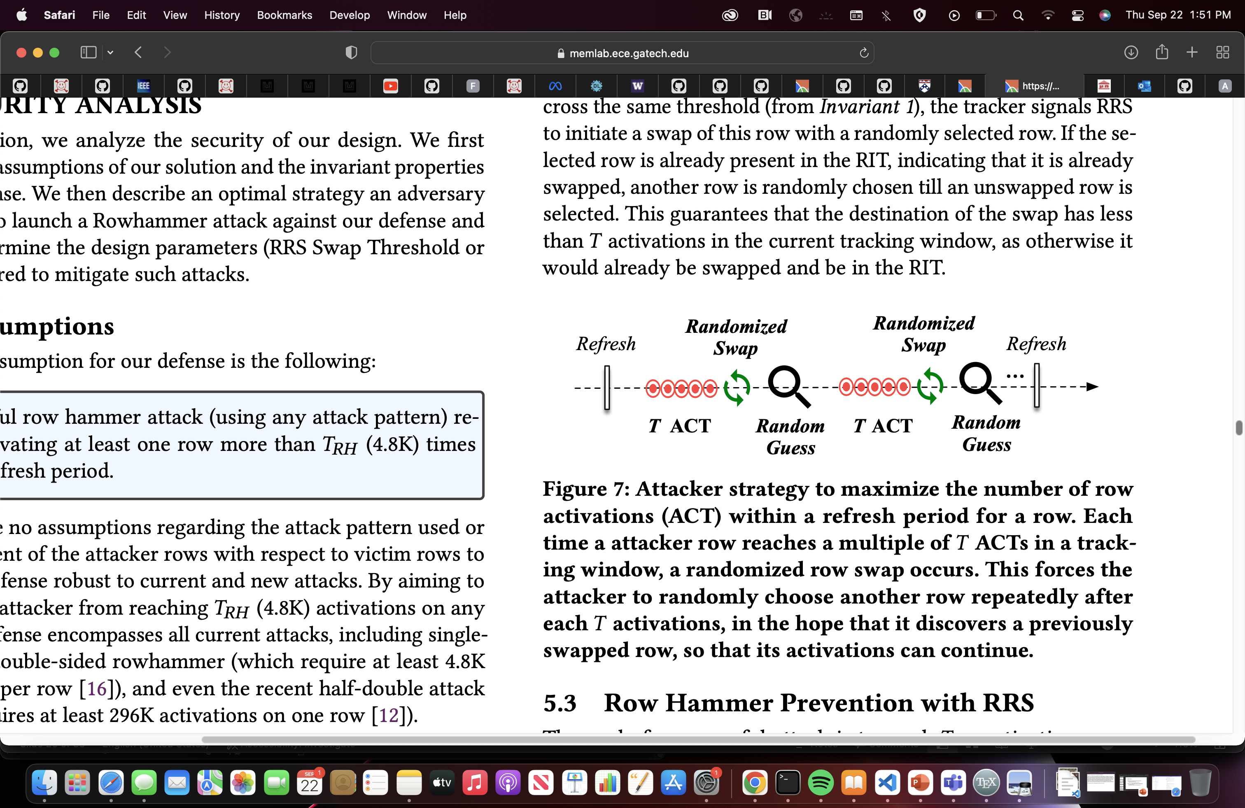
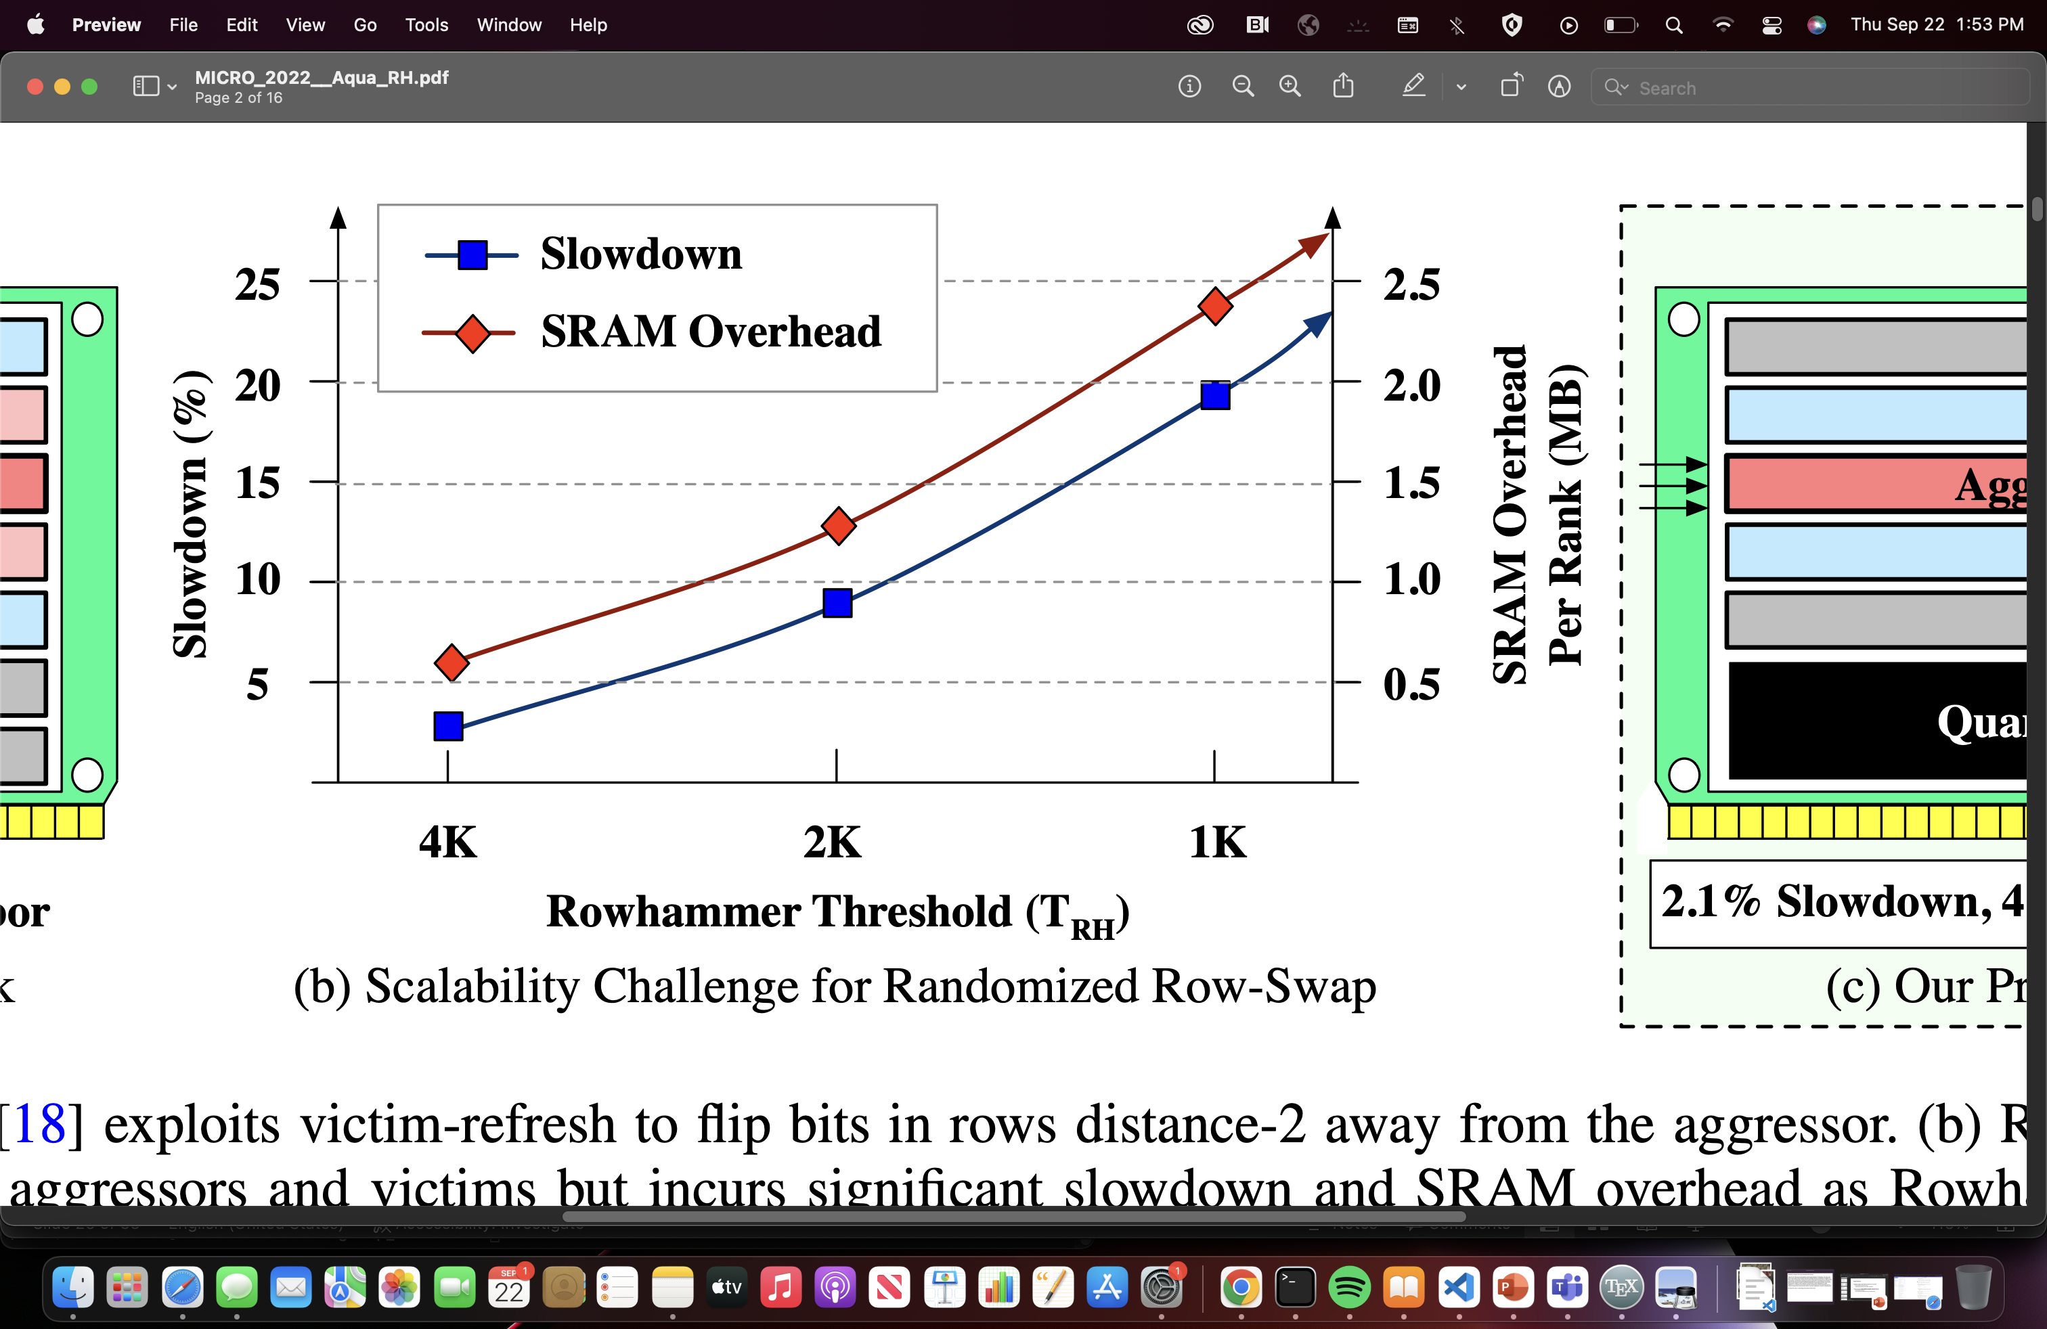
Row Swapping and its Limitations
Probabilistic Security based on Randomization
For TRH, must swap every TRH/6 ACTs
Recently proposed Hydra tracker requires 30 KB of SRAM per rank
Table size ∝ 1/TRH
Row-Y
2.4 MB per rank!
Can we mitigate Rowhammer with low SRAM overhead, low performance loss, and stronger security guarantees?
Row Indirection Table
Victim Row
Aggressor Row
Buffer-1
Victim Row
Buffer-2
2.74us
Row-X
SRAM
DRAM

Slide 36

AQUA: Quarantining Aggressors
No reduction in RTH (except due to tracker inefficiency)
Less migrations and lower mitigation cost
Security guarantees are simple due to isolation
172 KB per rank
Forward Pointer Table
Victim Row
Reverse Pointer Table
Aggressor Row
Buffer-1
Victim Row
Security requirement: No premature evictions
Rmax ∝ 1/f(TRH, tmov)
1.37us
RQA-R1
Teff | RQA-size | DRAM overhead (16GB memory)
500 | 180MB | 1.1%
125 | 290MB | 1.8%
1 | 364MB | 2.2%
Row Quarantine Area (RQA)
RQA-R2
SRAM
DRAM

